Slide 1

Visual Studio Code
Introduction

Slide 2



Prerequisite
Use Workshop-VM / Workshop-Computer follow the instructions of the Boarding Pass
Additional Material inside the [WORKSHOP] Folder
Visual Studio Code
https://code.visualstudio.com
Competence Team DevTech
Microsoft AL

Slide 3
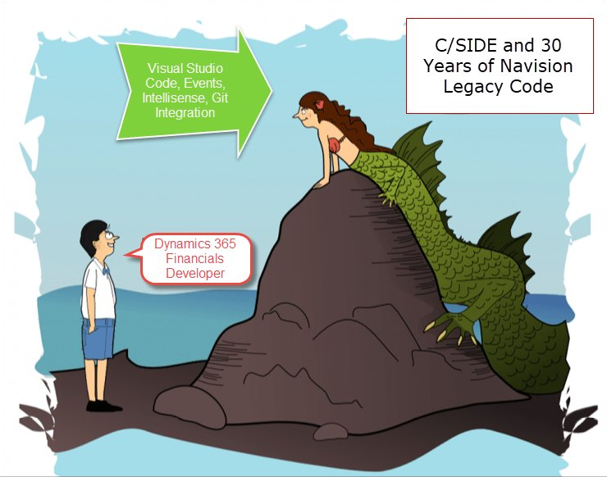
Agenda
1
Visual Studio Code
2
Prepare the NST
3
Getting Started with AL
4
The cool stuff of VS Code
5
Q & A

Slide 4

Visual Studio Code
User Interface
Extend & Configure VS Code

Slide 5
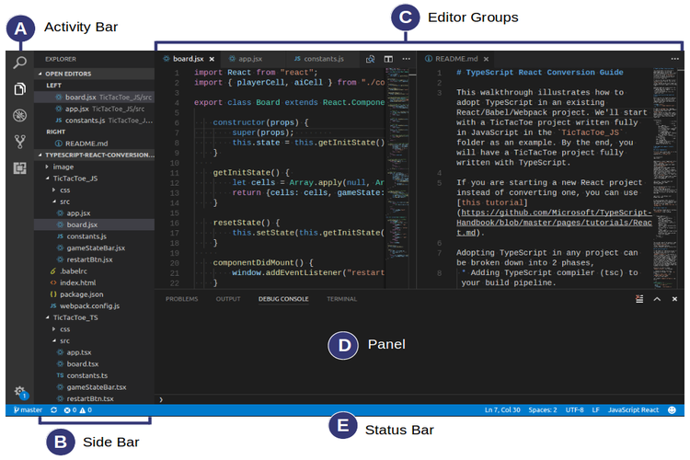
Visual Studio Code
Activity Bar
Search
Explorer
Debug
GIT
VS Code Extensions
Side Bar
Branch
Errors & Warnings
Editor Groups
Panel
Output
Console (PowerShell)
Status Bar

Slide 6
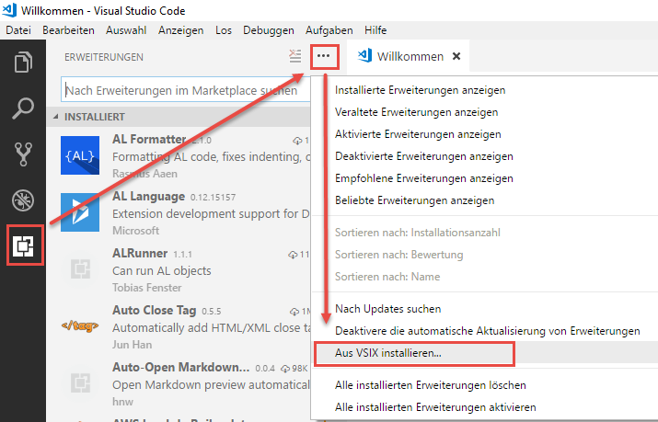
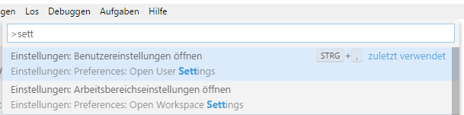
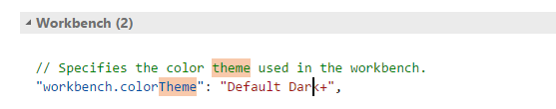
VS Code - Extensions & Settings
Extensions
Microsoft AL (VSIX / Marketplace)
MarkDown
Settings
Default
User
Workspace

Slide 7
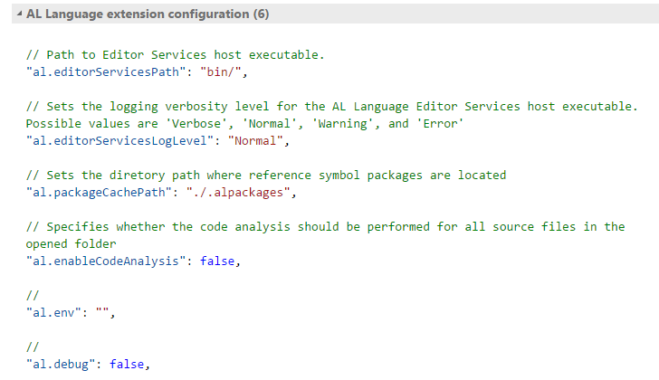
AL Language Settings
Package Directory
al.packageCachePath
al.enableCodeAnalysis

Slide 8
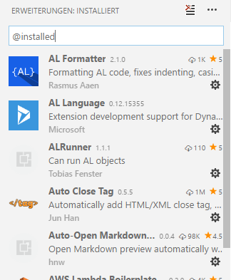
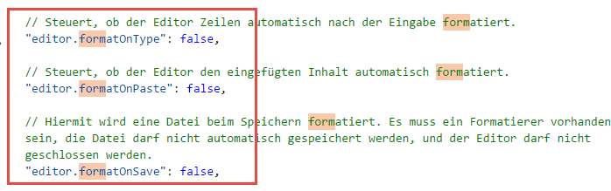
Hands On!
Start VS Code & Install some extensions
Micorsoft AL (from .vsix)
AL Formatter
JSON Syntax
Markdownlint
Auto-Open Markdown Preview
MDTools
Modify VS Code settings
Switch the theme of your VS Code to e.g. “White”
TurnOff Auto Format

Slide 9


NAV 2018
Get Ready for Development!

Slide 10
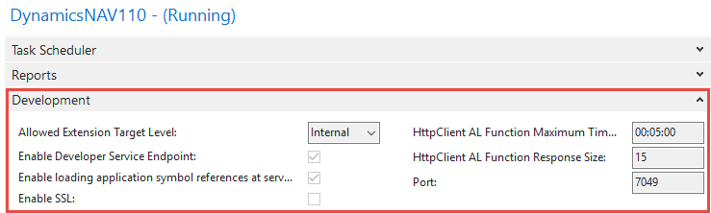
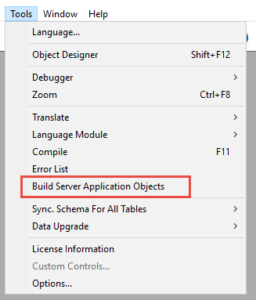
NAV 2018 Configuration / Development Settings
Specify the Customization Level
„Allowed Extension Target Level“ (Internal, Solution, Extension, Personalization)
Connect VS Code & Debugger
Enable Developer Service Endpoint
Port
Running C/Side & AL Side-by-Side
„Loading application Symbol References at startup“
finsql.exe generatesymbolreference=yes
Changing NST Configuration:
NST-Admin Center
CustomSettings.config

Slide 11


Microsoft AL
Which files you should know?
My first Project – Your first challenge!

Slide 12
Getting Started with AL
Project - Folder
./ → Root-Folder = Workspace of the Project
.vscode → Workspace related information
.git → All necessary information for your project in version control Git
.alpackages → Folder for Symbols
Project - Files
.vscode/launch.sjon → Deployment / Launch-Configuration
./app.json → Application Manifest
./Readme.md → Documentation File in MarkDown Format

Slide 13
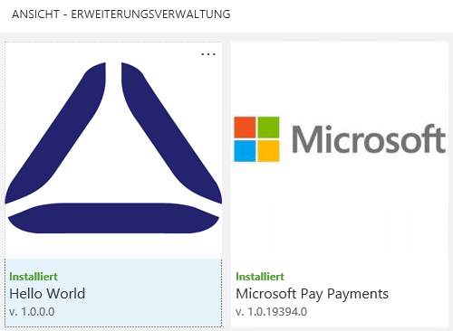
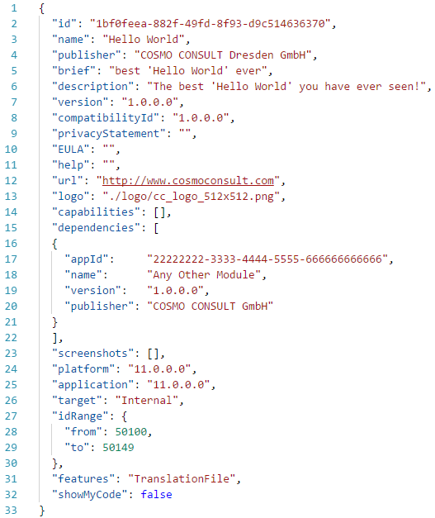
app.json
Application Manifest Information
ID
Name
Publisher
Version
Dependencies to other Apps
Platform / Application
Target
Personalization, Extension, Solution, Internal → Access-Level for the project
ID Range
Features
XLIFF Translation File
showMyCode

Slide 14
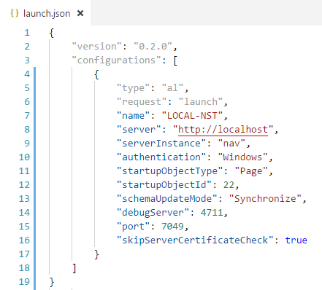
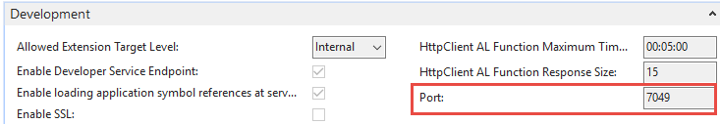
launch.json
Enable the Developer Service Endpoint
→ NST
Specify the Developer Endpoint
Name
Server (no port number here)
Server Instance
Port & Debug Server → default Ports 7049 / 4711
Authentication → UserPassword | Windows | AAD
Schema Update Mode → Synchronize | Recreate
Startup Object Id
Startup Object Type → Page | Table

Slide 15
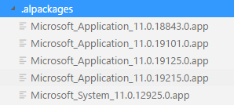
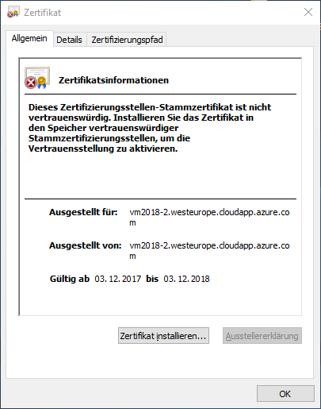
Symbols
Folder ./.alpackages
Packed JSON
Interface of each accessible Object in NAV
Pages, Tables, Fields, Events, …
Symbols
Microsoft_Application → Current Symbols of [C/Side] NAV
Microsoft_System → Symbols of NAV Version
Download Symbols
[Ctrl + Shift + P] + „Download Symbols“

Slide 16
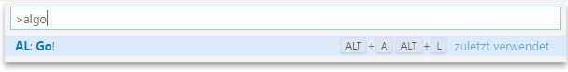
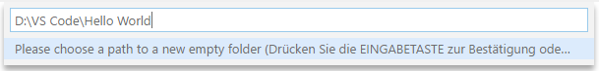
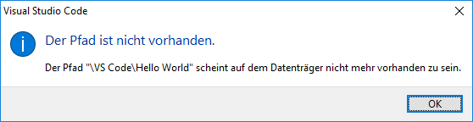
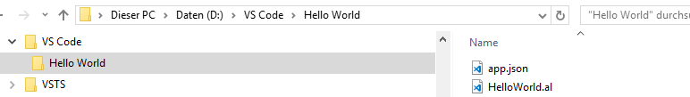
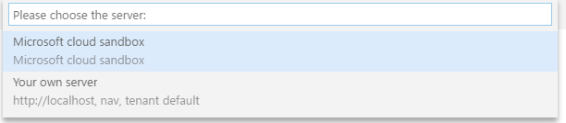
My first AL Project
[Ctrl + Shift + P] … AL: Go!
Generate an AL project with necessary files
Select a Folder ☺
Choose the Server for config
Project Content
./.vscode/launch.json
./app.json
./Hello World.al
Download Symbols
Compile, Deploy & Start

Slide 17

Hands On!
Hallo World
Create a Microsoft AL Project „Hello World“
Configure your app.json Publisher, Logo, Description, …
Configure your launch.json Server, Authentication, ServiceInstance, Tenant, Port, …
Deploy the Code
Debug the „Hello World“
Assign a BreakPoint
Inspect the „Rec“

Slide 18


Visual Studio Code Features
Short Cuts
Debugger
Snippets

Slide 19
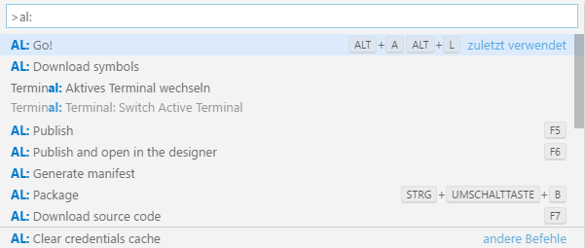
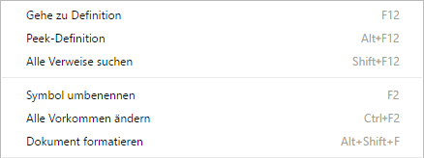
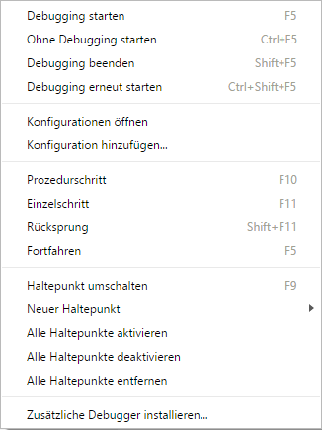
Important Commands
VS Code Commands [Ctrl + Shift + P] or [F1]
AL: Go! [Alt + A] & [Alt + L]
AL: Download Symbols
AL: Package
AL: Download Source Code
AL: Publish
Keyboard Shortcuts [Ctrl + K] & [Ctrl + S]
Editor Commands
[F2] … Rename Object / Property / …
[F12] … Goto Definition
[Ctrl + F12] … Goto Implementation
[Shift + F12] … Show Where the reference is Used
[Ctrl + B] … Compile / Build
[F5] … Publish and Start
[Ctrl + F5] … Publish without Debug

Slide 20
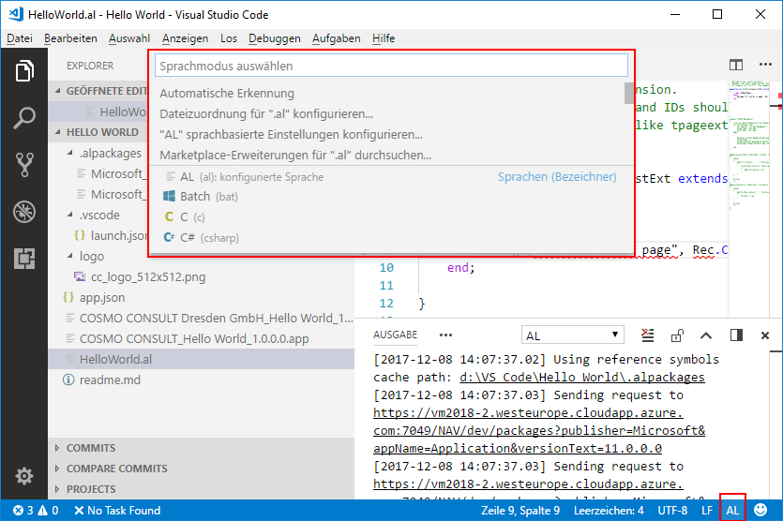
Syntax Highlighting
Change Language Mode
[Ctrl + K] & [M]
Status Bar

Slide 21
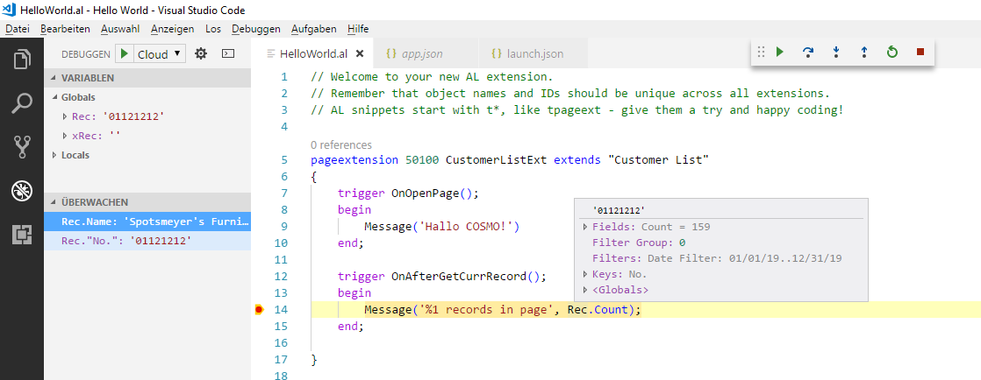
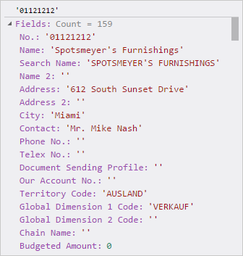
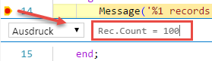
Debugger
Common Tasks
Break Points [F9]
Start Debugging [F5]
Features
Conditional Break Points
Inspect Variables
Debug C/Side Code (from Event Subscribers) → Generated AL

Slide 22
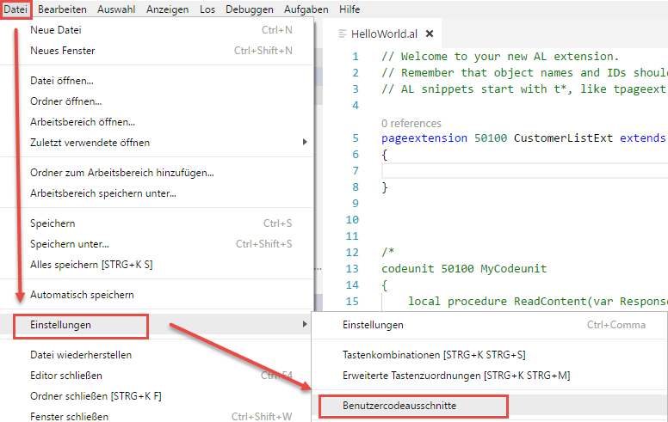
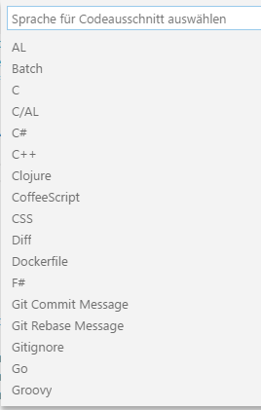
Snippets
Common Snipptes (e.g. AL Language)
ttable
tcodeunit
tfieldtext
User Snippets
File → Preferences
(languageId).json → al.json

Slide 23
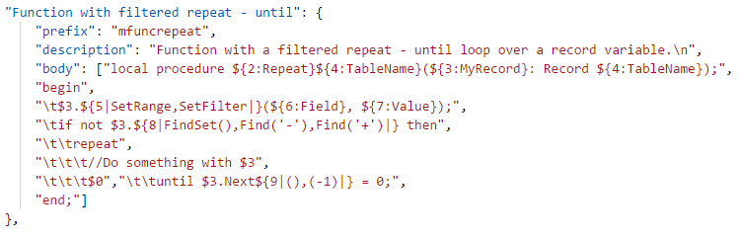
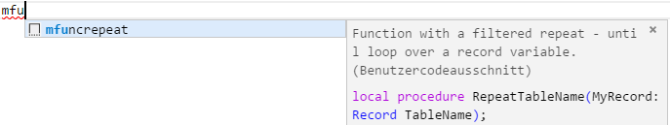
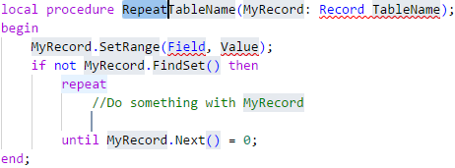
User Snippets
Snippet Name
Description
Body
Array of Lines
Parameters
${<Index>} … User Input
${1:param-name} … Name
${2|Value 1,Value 2,Value 3|} … Name-List
$<Index> … Place Holder

Slide 24
Hands On!
Debug the „Hello World“
Assign a BreakPoint
Inspect the „Rec“
Create your own snippet
Code:
if not MyRecord.FindSet() then repeat // Do something with MyRecord until MyRecord.Next() = 0;
Add a Parameter for “MyRecord”
Add a Selection List for “FindSet()”: e.g.: FindSet(),Find('-'),Find('+')

Slide 25

Q & A
Visual Studio Code
https://code.visualstudio.com
Competence Team DevTech
Channel Microsoft AL

